Slide 1
Prevention of Postoperative Complications After Cardiac Surgery:
Viachaslau Barodka, M.D. Assistant Professor
Division of Cardiac Anesthesia
Presented by: Viachaslau Barodka, M.D.

Slide 2
The Johns Hopkins Hospital
Notes:
buffering function of large arteries (windkessel effect), a process that normally provides a continuous blood flow when the heart is between contractions in order to supply oxygen to peripheral tissues. Arteries lose this function as they stiffen, so the heart has to work harder and the coro- nary flow is reduced, potentially leading to ischemia

Slide 3
Baltimore, Maryland
Notes:
buffering function of large arteries (windkessel effect), a process that normally provides a continuous blood flow when the heart is between contractions in order to supply oxygen to peripheral tissues. Arteries lose this function as they stiffen, so the heart has to work harder and the coro- nary flow is reduced, potentially leading to ischemia

Slide 4
Patient Population
Notes:
buffering function of large arteries (windkessel effect), a process that normally provides a continuous blood flow when the heart is between contractions in order to supply oxygen to peripheral tissues. Arteries lose this function as they stiffen, so the heart has to work harder and the coro- nary flow is reduced, potentially leading to ischemia

Slide 5
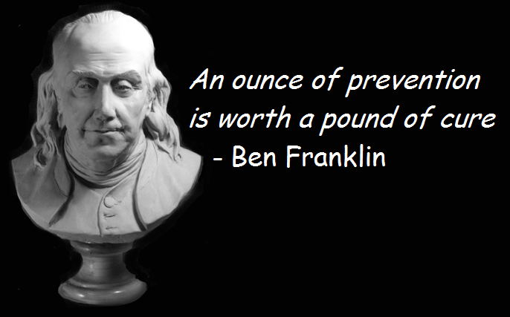
Key to Success : Prevention
Notes:
buffering function of large arteries (windkessel effect), a process that normally provides a continuous blood flow when the heart is between contractions in order to supply oxygen to peripheral tissues. Arteries lose this function as they stiffen, so the heart has to work harder and the coro- nary flow is reduced, potentially leading to ischemia

Slide 6
Key to Success : Incentives To Health Care System
Notes:
buffering function of large arteries (windkessel effect), a process that normally provides a continuous blood flow when the heart is between contractions in order to supply oxygen to peripheral tissues. Arteries lose this function as they stiffen, so the heart has to work harder and the coro- nary flow is reduced, potentially leading to ischemia

Slide 7
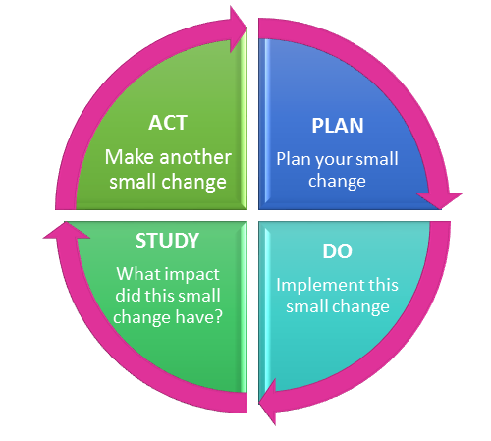
Implement Change and Measure Outcome
Notes:
buffering function of large arteries (windkessel effect), a process that normally provides a continuous blood flow when the heart is between contractions in order to supply oxygen to peripheral tissues. Arteries lose this function as they stiffen, so the heart has to work harder and the coro- nary flow is reduced, potentially leading to ischemia

Slide 8
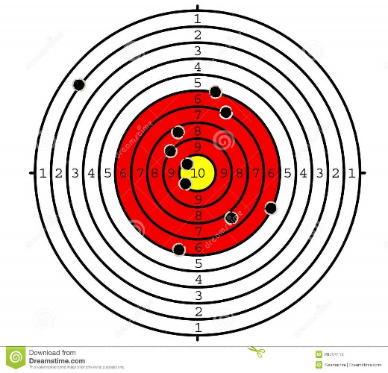
Implement Change and Measure Outcome Everybody Thinks He is Great Gunmen Until He Sees The Target
Notes:
buffering function of large arteries (windkessel effect), a process that normally provides a continuous blood flow when the heart is between contractions in order to supply oxygen to peripheral tissues. Arteries lose this function as they stiffen, so the heart has to work harder and the coro- nary flow is reduced, potentially leading to ischemia

Slide 9
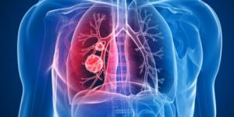
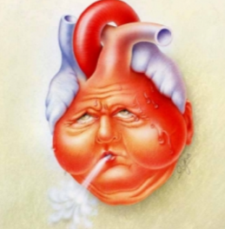
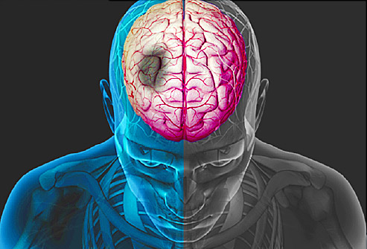
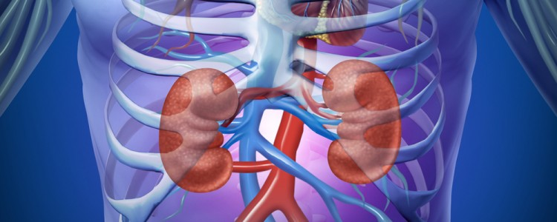
Prevention: What Kills Our Patients ?
Notes:
buffering function of large arteries (windkessel effect), a process that normally provides a continuous blood flow when the heart is between contractions in order to supply oxygen to peripheral tissues. Arteries lose this function as they stiffen, so the heart has to work harder and the coro- nary flow is reduced, potentially leading to ischemia

Slide 10
Infection Prevention
MRSA Screen - Nasal Mupirocine - Vancomycin
Chlorhexidine scrab
Ancef bolus + drip
Notes:
buffering function of large arteries (windkessel effect), a process that normally provides a continuous blood flow when the heart is between contractions in order to supply oxygen to peripheral tissues. Arteries lose this function as they stiffen, so the heart has to work harder and the coro- nary flow is reduced, potentially leading to ischemia

Slide 11
Bleeding Prevention
Type & Screen & Cross 4 PRBCs
Aminocaproic acid
Thromboeslastogram
Platelet count
Fibrinogen
Rapid infusor in necessary
Large central lines
Notes:
buffering function of large arteries (windkessel effect), a process that normally provides a continuous blood flow when the heart is between contractions in order to supply oxygen to peripheral tissues. Arteries lose this function as they stiffen, so the heart has to work harder and the coro- nary flow is reduced, potentially leading to ischemia

Slide 12
Postoperative Pneumonia Prevention
Lung protective ventilation mode
VAP Bundle in ICU
Extubation within 6 -12 hours
Early ambulation
Notes:
buffering function of large arteries (windkessel effect), a process that normally provides a continuous blood flow when the heart is between contractions in order to supply oxygen to peripheral tissues. Arteries lose this function as they stiffen, so the heart has to work harder and the coro- nary flow is reduced, potentially leading to ischemia

Slide 13
Arrhythmia Prevention
Amiodarone
DDD or AAI mode on pacemaker
Check grafts flow
Notes:
buffering function of large arteries (windkessel effect), a process that normally provides a continuous blood flow when the heart is between contractions in order to supply oxygen to peripheral tissues. Arteries lose this function as they stiffen, so the heart has to work harder and the coro- nary flow is reduced, potentially leading to ischemia

Slide 14
Poor Heart Function
Intraop TEE
IABP
ECMO
NO or Valetri for RV
Notes:
buffering function of large arteries (windkessel effect), a process that normally provides a continuous blood flow when the heart is between contractions in order to supply oxygen to peripheral tissues. Arteries lose this function as they stiffen, so the heart has to work harder and the coro- nary flow is reduced, potentially leading to ischemia

Slide 15
Emergency Surgery
Timely operation
OR ready
Notes:
buffering function of large arteries (windkessel effect), a process that normally provides a continuous blood flow when the heart is between contractions in order to supply oxygen to peripheral tissues. Arteries lose this function as they stiffen, so the heart has to work harder and the coro- nary flow is reduced, potentially leading to ischemia

Slide 16
Stroke Preventionn
Keep MAP >
Lower Limit of Autoregulation
Notes:
buffering function of large arteries (windkessel effect), a process that normally provides a continuous blood flow when the heart is between contractions in order to supply oxygen to peripheral tissues. Arteries lose this function as they stiffen, so the heart has to work harder and the coro- nary flow is reduced, potentially leading to ischemia

Slide 17
Acute Kidney Injury Prevention
Goal Directed Perfusion Protocol
Prevention of Hemolysis
Minute to minute Urine Output
Notes:
buffering function of large arteries (windkessel effect), a process that normally provides a continuous blood flow when the heart is between contractions in order to supply oxygen to peripheral tissues. Arteries lose this function as they stiffen, so the heart has to work harder and the coro- nary flow is reduced, potentially leading to ischemia

Slide 18
Iatrogenic Causes Prevention
Make surgeon :
Relaxed
Confident
Positive Attitude
Notes:
buffering function of large arteries (windkessel effect), a process that normally provides a continuous blood flow when the heart is between contractions in order to supply oxygen to peripheral tissues. Arteries lose this function as they stiffen, so the heart has to work harder and the coro- nary flow is reduced, potentially leading to ischemia

Slide 19
Key to Success : Leadership Willing To Change
Notes:
buffering function of large arteries (windkessel effect), a process that normally provides a continuous blood flow when the heart is between contractions in order to supply oxygen to peripheral tissues. Arteries lose this function as they stiffen, so the heart has to work harder and the coro- nary flow is reduced, potentially leading to ischemia

Slide 20
THANK YOU !

